Slide 1

AMS Reskill
11th October

Slide 2
Overview
Logistics
Overview of training
Progress Monitoring
Feedback
Learner Support

Slide 3
Logistics

Slide 4
Hours of Training
Monday = 10:00-16:45
Tuesday-Thursday = 9:00-16:45
Friday = 9:00-15:00
Please arrive to your session promptly, ready to begin the day.

Slide 5
Delivery Platforms
Most of your training will be held in MS Teams
You will receive an invite to the MS Team on Friday 14th October, alongside an invitation to a Tech Clinic in case you have any issues logging in.
Three modules which will be held in WebEx:
AWS Cloud Practitioner
Scrum Alliance Certified Practitioner
Jira Essentials
As this is a certified element of the bootcamp. Further details will be sent to you via email.

Slide 6
Bootcamp overview

Slide 7
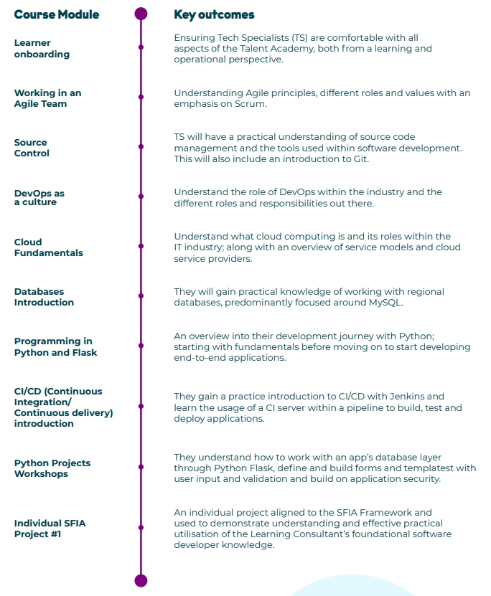


Slide 8
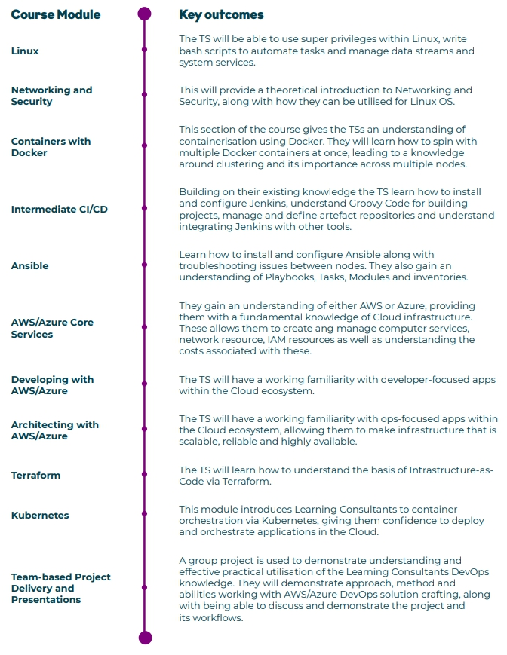




Slide 9
Five Day Programme (In Person)
Day 1
Day 3
Day 2
Managing yourself professionally
Presentation Skills
Days 4 & 5
Presentations
Brilliant Resilient
Soft Skill Introduction
Difficult Conversations

Slide 10
Progress Monitoring

Slide 11
Progress Monitoring
Attendance
Taken every AM & PM learners attendance is recorded and feedback to AMS.
Weekly Progress Tracker
Trainers formatively assess weekly in terms of soft skills, attitude & tech skills
Each area is scored out of 5
These scores are supplemented with commentary in terms of their strengths, weaknesses & goals
1 & 2 = Cause for concern
3 = Meets expectations
4 & 5 = Exceeds expectations
Notes:
We take an active approach to tracking l

Slide 12
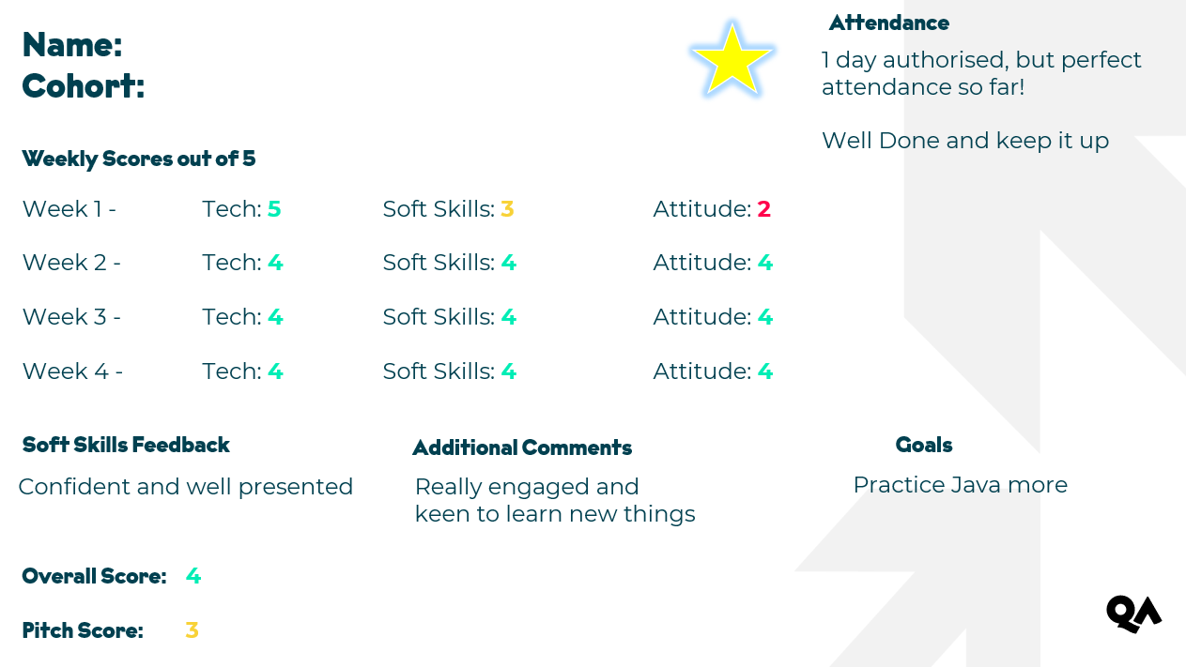

Progress Reports
This will be shared with you every 4 weeks:

Slide 13
Feedback

Slide 14
Learner Reflection & Feedback
We encourage learners to self-reflect regularly:
Learners complete weekly feedback where they conduct a SWOT analysis on their learning, set goals and provide feedback on their experience
This correlates to our trainer feedback to give a well-rounded picture of their experience and progression
Example:
Weekly Learner Reflection & Feedback

Slide 15
Learner Support

Slide 16
If anything is preventing you from making the most out of your training please contact:
AcademyQAC@qa.com
We aim to respond within 8 working hours ☺

